Slide 1
Error Analysis and Graphs

Slide 2

Important Notes
Taken tolerance values
δ y1 = 1 mm = 0.001cm
δ y2 = 1 mm = 0.001cm
δ t = 0.1 s
For simplicity in formulae, we represent
Experimental Conjugate Depth = J
Froude Number = Fr
Experimental Specific Energy Loss = E
All calculations have been performed on MS Excel and all graphs have been plotted and labelled using MATLAB.

Slide 3
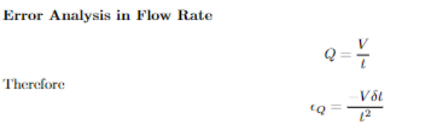
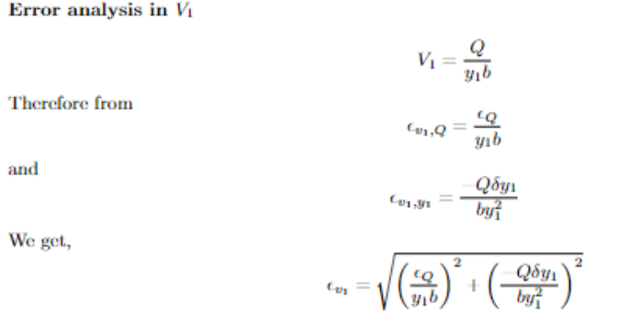
Error Analysis

Slide 4
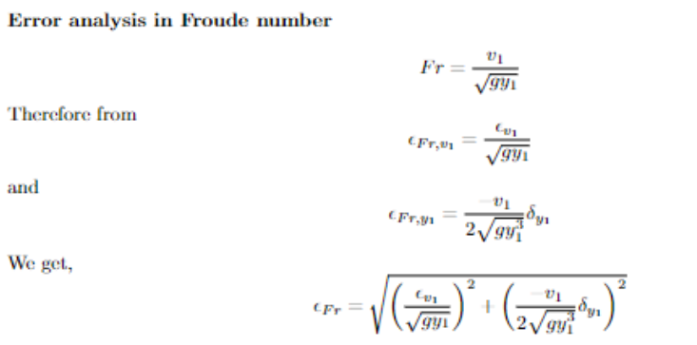
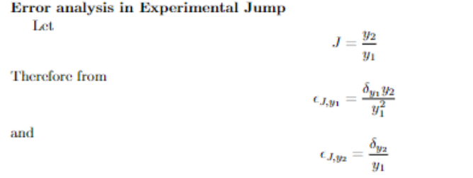
Error Analysis

Slide 5
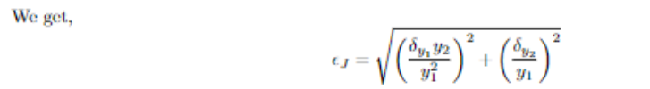
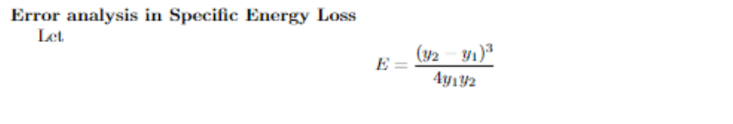
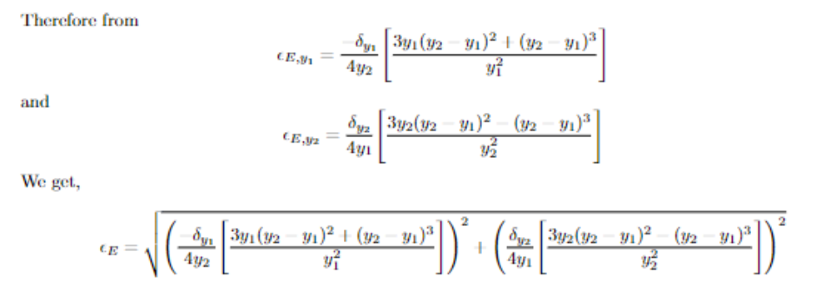
Error Analysis

Slide 6
Error Analysis
After calculating and arranging all the obtained values using excel, we get
δ Q = -0.00000256
Error Table
δ Fr | δ J | δ E
2.52863 | 1.21655 | 0.00863
1.48208 | 0.41321 | 0.00174
1.02669 | 0.20591 | 0.00041
0.77777 | 0.12012 | 0.00001

Slide 7
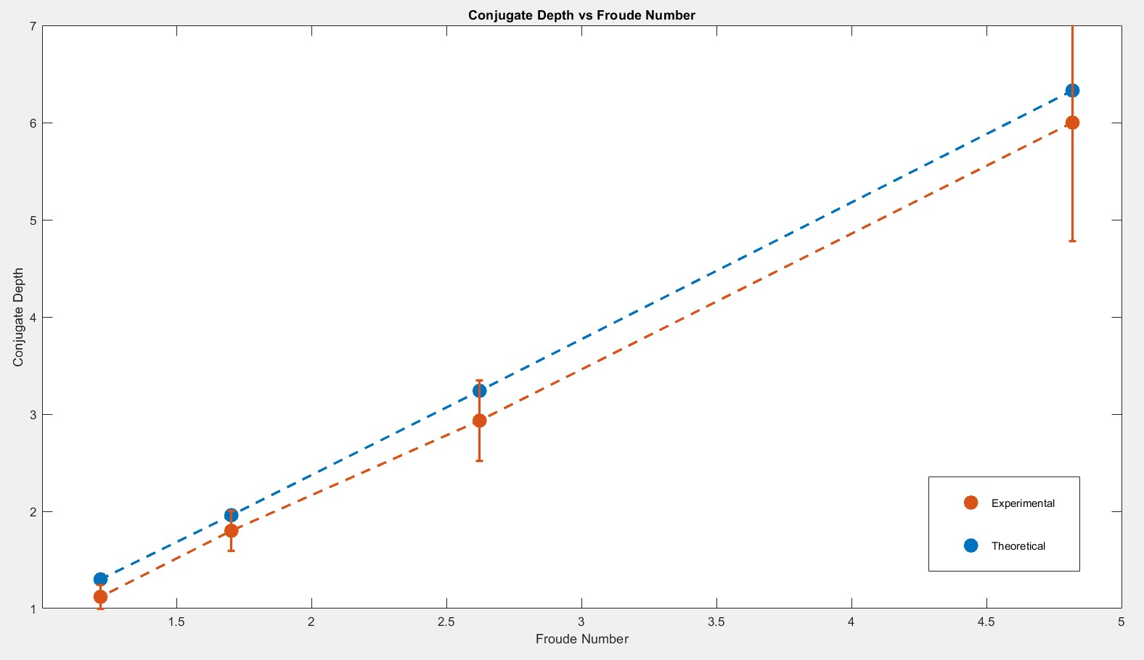
Graphs

Slide 8
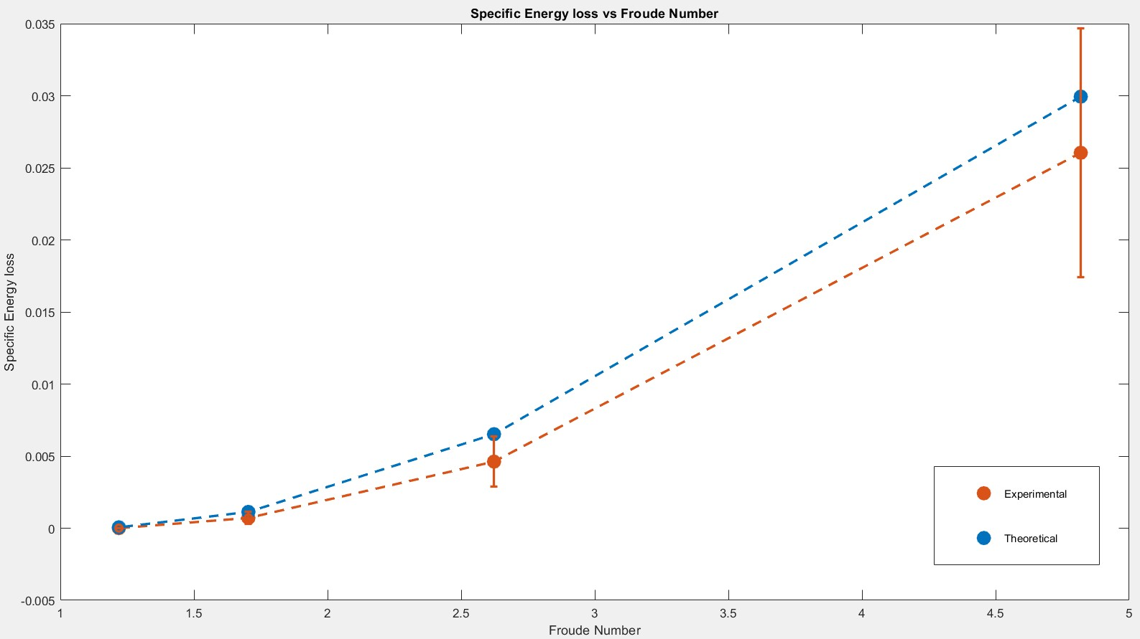
Graphs

